Slide 1
Illustrations Talking Points for Fair Use in Writing about Art

Slide 2
Other Criteria, Leo Steinberg, 1972, page spread with images of works by Matisse and Picasso, pp. 134-135.

Slide 3
Other Criteria, Leo Steinberg, 1972, page spread showing four versions of entwined double faces by Picasso from 1940-41, pp. 202-03.

Slide 4
Other Criteria, Leo Steinberg, 1972, images of Picasso’s Variations on Delacroix’s “Women of Algiers,” page 234 (fold-out spread)

Slide 5
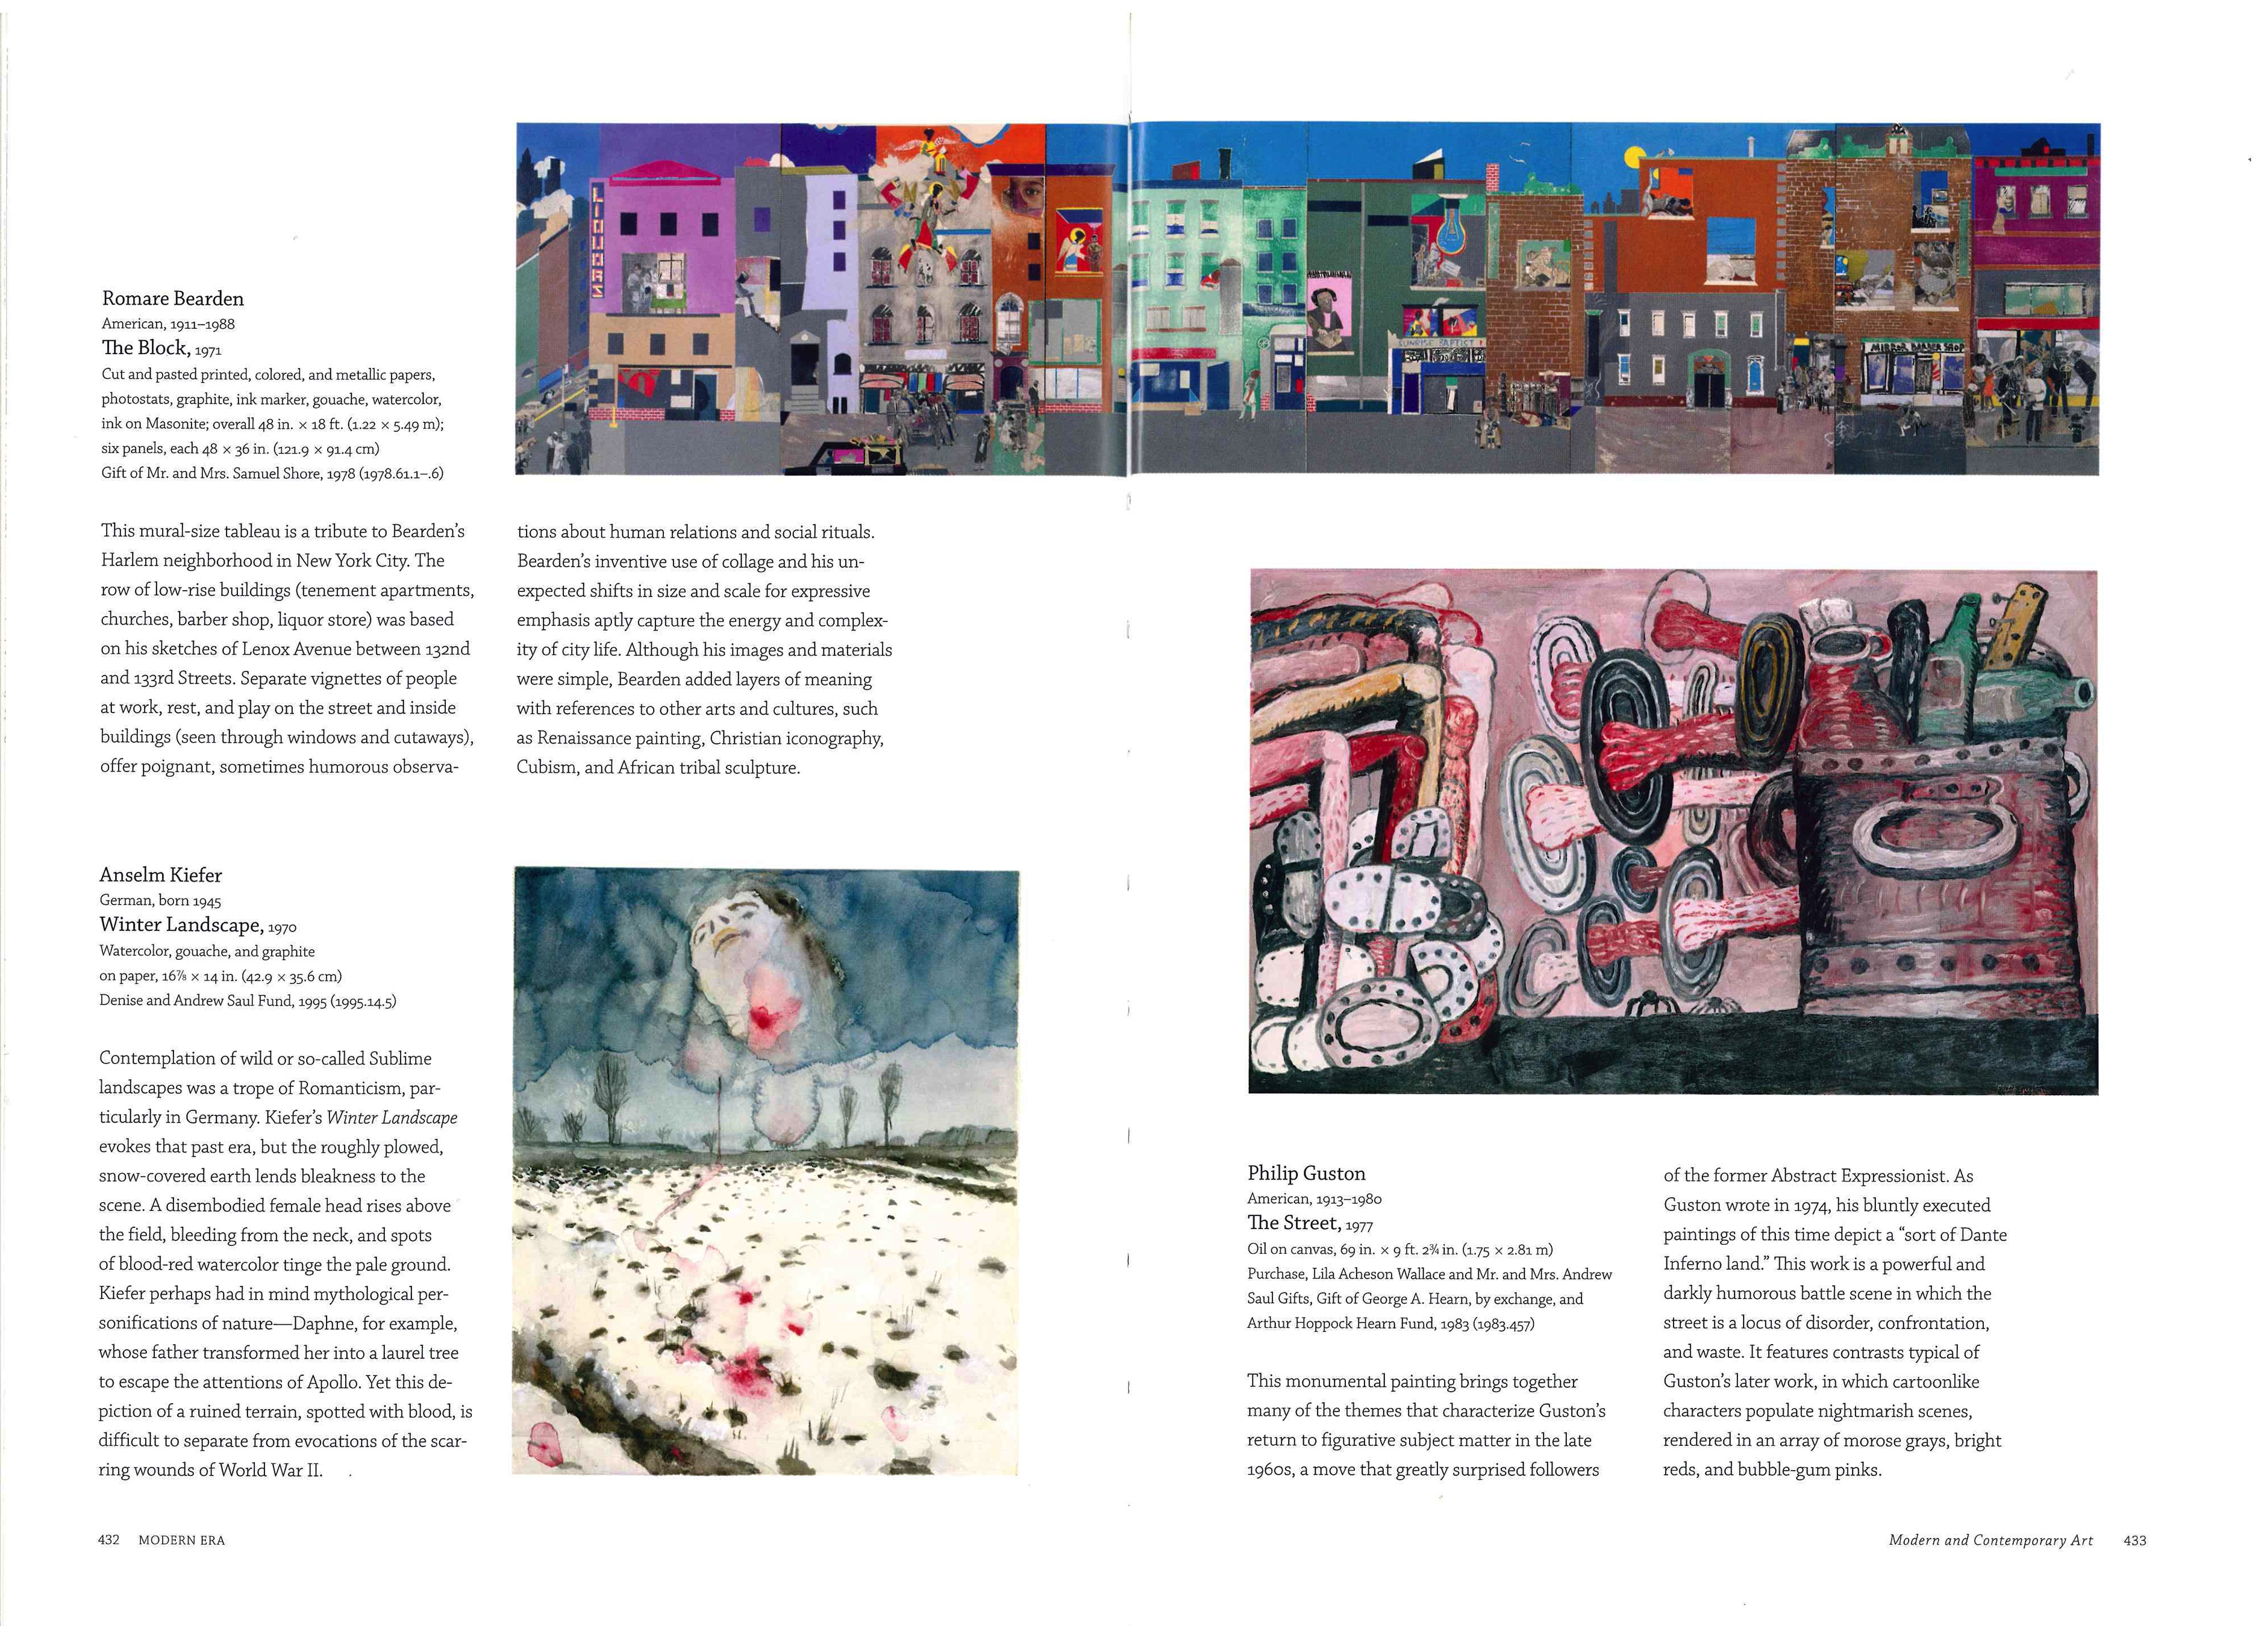
Guide, Metropolitan Museum of Art, 2012, pp. 432-33

Slide 6
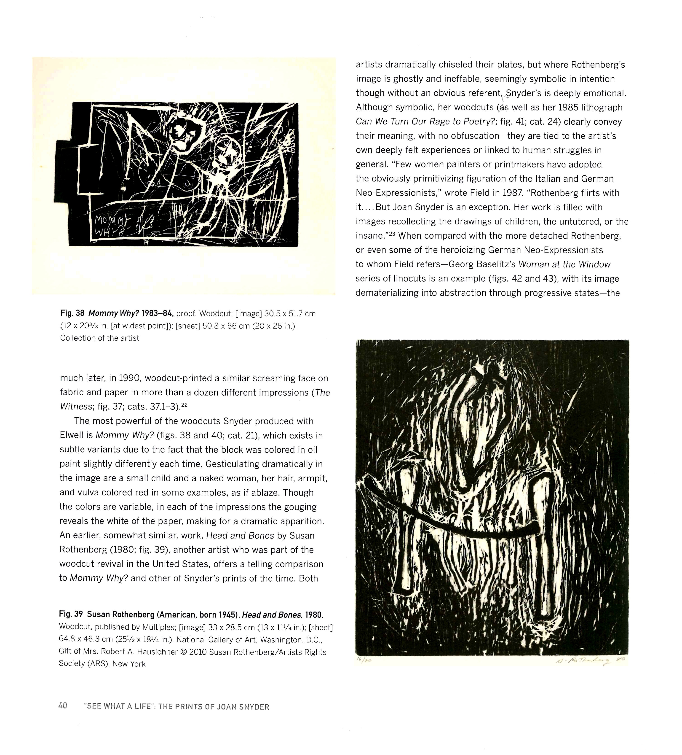
Dancing with the Dark: Joan Snyder Prints 1963-2010, exhibition at the Zimmerli Art Museum, January 29 - May 29, 2011, organized by Marilyn Symmes, catalogue by Marilyn Symmes and Faye Hirsch. Page 40 includes a print by Snyder from the exhibition (upper left), and a comparison image of a print by Susan Rothenberg.

Slide 7
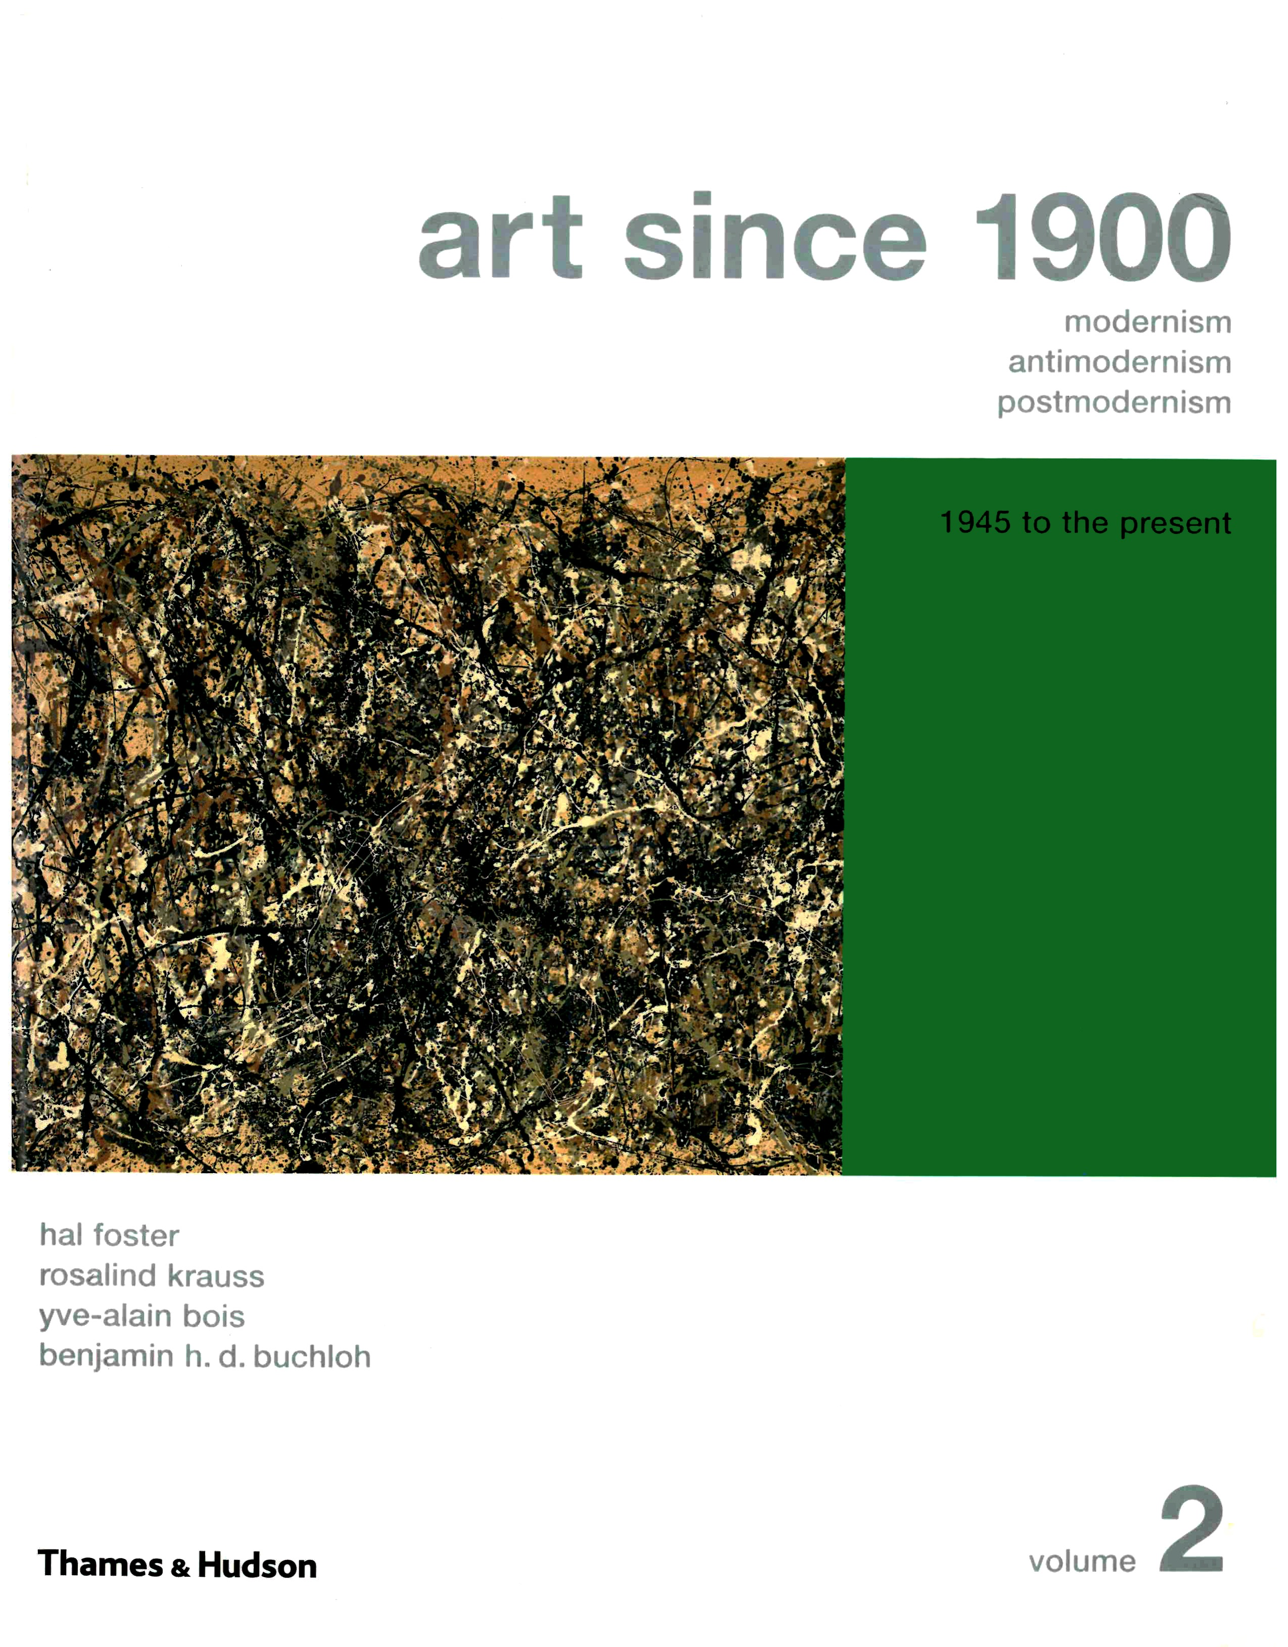
Art Since 1900: 1945 to the Present, Hal Foster, Rosalind Krauss, Yve-Alain Bois, Benjamin H.D. Buchloh, 2004, reprinted 2007

Slide 8
All images in this PowerPoint were taken from the Internet and are used according to the copyright doctrine of fair use.

